Slide 1


BJIT Academy
Design Patterns: Elements of Reusable Object-Oriented Software
Nani Gopal Barai 20th Apr 2021

Slide 2
Training Contents
#SL No | No of sessions (1 hour) | Topic
1 | 1 | OOP(Object, Inheritance, Interface, Polymorphism)
2 | 1 | What is Design Pattern and Why we need to learn them? Classification of Design Patterns and Demonstration of (1) Singleton and (2) Adapter Design Patterns
3 | 1 | Demonstration of (3) Strategy, (4) Bridge and (5) Composite Design Patterns
4 | 1 | Demonstration of (6) Factory Method, (7) Abstract Factory and (8) Decorator Design Patterns
5 | 1 | Demonstration of (9) Observer, (10) Command and (11) Builder Design Patterns
6 | 1 | Demonstration of (12) Flyweight, (13) Interpreter and (14) Prototype Design Patterns
7 | 1 | Demonstration of (15) Proxy, (16) Iterator and (17) Template Method Design Patterns
8 | 1 | Final Exam

Slide 3
What is Design Pattern?
Design Pattern – Definition & Origin: Christopher Alexander says, "Each pattern describes a problem which occurs over and over again in our environment, and then describes the core of the solution to that problem, in such a way that you can use this solution a million times over, without ever doing it the same way twice".
Even though Alexander was talking about patterns in buildings and towns, what he says is true about object-oriented design patterns. Our solutions are expressed in terms of objects and interfaces instead of walls and doors, but at the core of both kinds of patterns is a solution to a problem in a context.

Slide 4
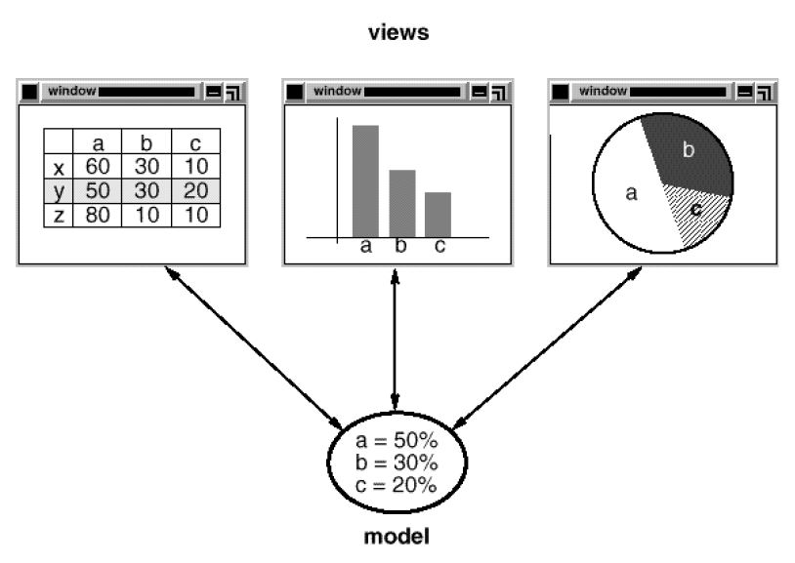
Why Design Pattern?
Reason to use Design Pattern with an example:
What:
The Model/View/Controller (MVC) triad of classes is used to build user interfaces in Smalltalk-80.
Looking at the design patterns inside MVC should help you see what we mean by the term "pattern.“

Slide 5
Example of Design Pattern?
Reason to use Design Pattern with an example: (Continued…)
How:
MVC consists of three kinds of objects.
The Model is the application object, the View is its screen presentation, and the Controller defines the way the user interface reacts to user input.
Before MVC, user interface designs tended to lump these objects together. MVC decouples them to increase flexibility and reuse.

Slide 6
Example of Design Pattern?
Reason to use Design Pattern with an example: (Continued…)
Why:
MVC decouples views and models by establishing a subscribe/notify protocol between them.
A view must ensure that its appearance reflects the state of the model.
Whenever the model's data changes, the model notifies views that depend on it.
In response, each view gets an opportunity to update itself.
This approach lets you attach multiple views to a model to provide different presentations.
You can also create new views for a model without rewriting it.

Slide 7
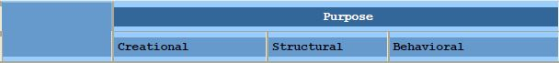
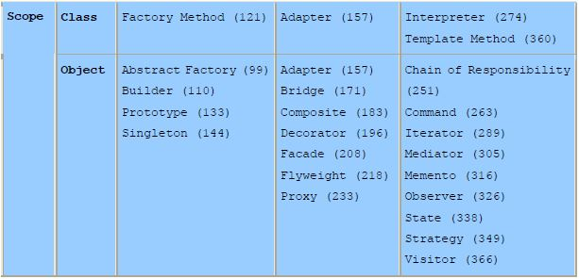
Classification of Design Pattern?
Classification of Design Patterns:
Design patterns vary in their granularity and level of abstraction. Because there are many design patterns, we need a way to organize them. We classify design patterns by two criteria(Figure-1).
Figure-1: Classification of Design Patterns based on Purpose and Scope

Slide 8
Classification of Design Pattern?
Classification of Design Patterns:
1. The first criterion, called purpose, reflects what a pattern does. Patterns can have either creational, structural, or behavioural purpose.
Creational patterns concern the process of object creation.
Structural patterns deal with the composition of classes or objects.
Behavioural patterns characterize the ways in which classes or objects interact and distribute responsibility

Slide 9
Classification of Design Pattern?
Classification of Design Patterns:
2. The second criterion, called scope, specifies whether the pattern applies primarily to classes or to objects.
Class patterns deal with relationships between classes and their subclasses.
These relationships are established through inheritance, so they are static—fixed at compile-time.
Object patterns deal with object relationships, which can be changed at run-time and are more dynamic.
Almost all patterns use inheritance to some extent.
So the only patterns labelled "class patterns" are those that focus on class relationships.
Note that most patterns are in the Object scope.

Slide 10
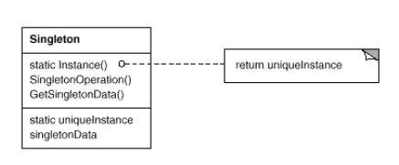
“Singleton” Design Pattern
Intent/ Definition: Ensure a class only has one instance and provide a global point of access to it.
Type: Creational Pattern
UML Diagram:
Context and Origin:
In software engineering, the singleton pattern is a software design pattern that restricts the instantiation of a class to one "single" instance.
This is useful when exactly one object is needed to coordinate actions across the system.
The term comes from the mathematical concept of a singleton.

Slide 11
“Singleton” Design Pattern (Continued….)
Motivation:
How do we ensure that a class has only one instance and that the instance is easily accessible? A global variable makes an object accessible, but it doesn't keep you from instantiating multiple objects.
A better solution is to make the class itself responsible for keeping track of its sole instance. The class can ensure that no other instance can be created (by intercepting requests to create new objects), and it can provide a way to access the instance. This is the Singleton pattern.
The singleton design pattern solves problems like:
How can it be ensured that a class has only one instance?
How can the sole instance of a class be accessed easily?
How can a class control its instantiation?
How can the number of instances of a class be restricted?
How can a global variable be accessed?
The singleton design pattern describes how to solve such problems:
Hide the constructor of the class.
Define a public static operation (getInstance()) that returns the sole instance of the class.

Slide 12
“Singleton” Design Pattern (Continued….)
Motivation: (Continued…)
The key idea in this pattern is to make the class itself responsible for controlling its instantiation (that it is instantiated only once).
The hidden constructor (declared private or protected) ensures that the class can never be instantiated from outside the class.
The public static operation can be accessed easily by using the class name and operation name (Singleton.getInstance()).
Common Uses:
The abstract factory, factory method, builder, and prototype patterns can use singletons in their implementation.
Facade objects are often singletons because only one facade object is required.
State objects are often singletons.

Slide 13
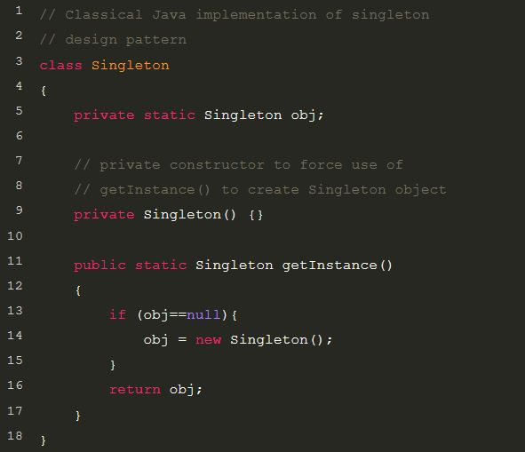
“Singleton” Design Pattern (Continued….)
Example: (Source Code)
Reference: 1. GOF Design Pattern Book 2. https://www.geeksforgeeks.org/singleton-design-pattern/ 3. https://en.wikipedia.org/wiki/Singleton_pattern

Slide 14
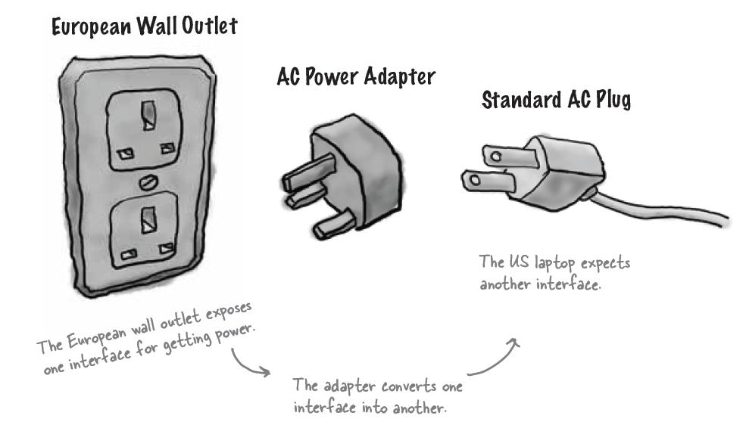
“Adapter” Design Pattern
Definition: Convert the interface of a class into another interface clients expect. Adapter lets classes work together that couldn't otherwise because of incompatible interfaces.
Type: Structural Pattern
UML Diagram:
Adapters All Around Us (Adapter used in real life): In European country to use US made Laptop an AC power adapter is necessary.

Slide 15
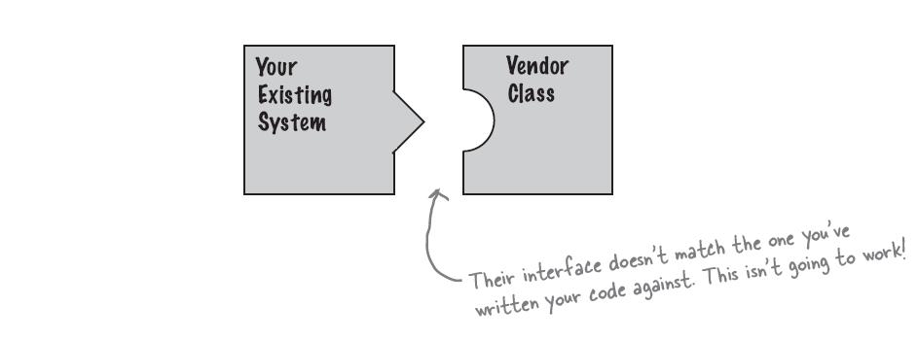
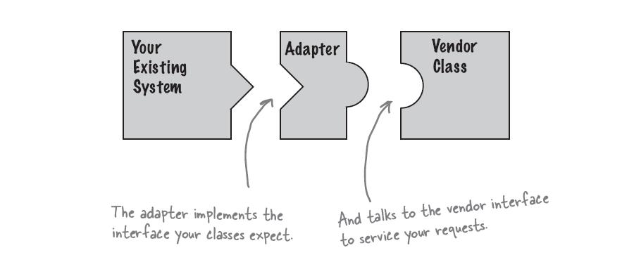
“Adapter” Design Pattern (Continued….)
Object Oriented Adapter: Say you have got an existing software system that you need to work a new vendor class library into, but the new vendor designed their interfaces differently than the last vendor.
Okay, you don’t want to solve the problem by changing your existing code (and you can’t change the vendor’s code). So what do you do? Well, you can write a class that adapts the new vendor interface into the one you are expecting.

Slide 16
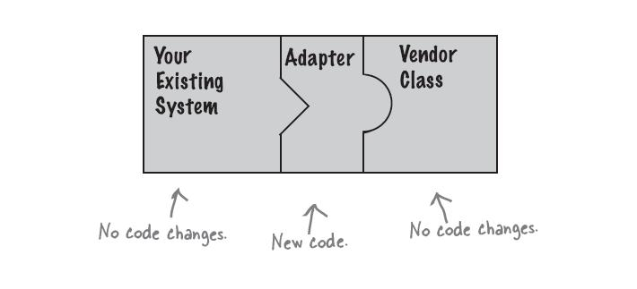
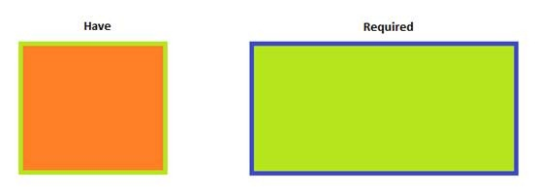
“Adapter” Design Pattern (Continued….)
The adapter act as the middleman by receiving requests from the client and converting them into requests that make sense on the vendor classes.
Example: Suppose, You have an existing software system (a Calculator class) that can calculates area with the method “public int getArea (Rectangle rectangle)” and method takes a rectangle object as input. But now you get a request from a new client to calculate area for a Square. How do you solve the issue without modifying existing software system?
Adapter design pattern can solve this problem efficiently in the following way: Following are the class definitions for Rectangle and Calculator.

Slide 17
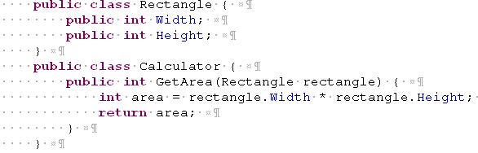
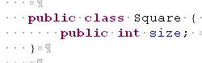
“Adapter” Design Pattern (Continued….)
As we can see from the above example an instance of Rectangle is needed to calculate the area. If we have a square class of definition below, the calculation cannot be done.
Here we have to create a new CalculatorAdapter to get the work done.

Slide 18
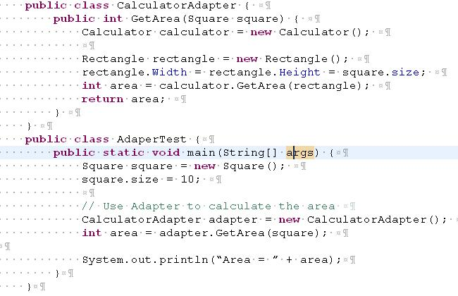
“Adapter” Design Pattern (Continued….)
Reference: 1. GOF Design Pattern Book 2. Head First Design Pattern Book 3. “http://jeanpaulva.com/tag/adapter-design-pattern/”

Slide 19
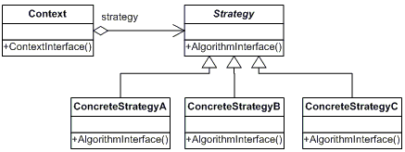
“Strategy” Design Pattern
Definition: Define a family of algorithms, encapsulate each one, and make them interchangeable. Strategy lets the algorithm vary independently from clients that use it.
Type: Behavioral Pattern
UML class diagram:

Slide 20
“Strategy” Design Pattern (Continued…)
Participants:
The classes and/or objects participating in this pattern are:
Strategy (CompressionStrategy)
It declares an interface common to all supported algorithms. Context uses this interface to call the algorithm defined by a ConcreteStrategy.
ConcreteStrategy (ZipCompressionStrategy, RarCompressionStrategy)
It implements the algorithm using the Strategy interface.
Context (CompressionContext)
is configured with a ConcreteStrategy object and maintains a reference to a Strategy object which may define an interface that lets Strategy access its data.

Slide 21
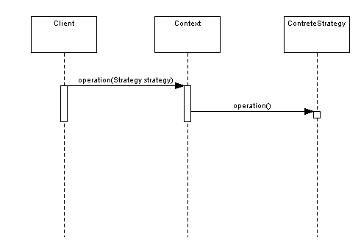
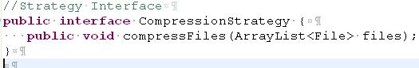
“Strategy” Design Pattern (Continued…)
Sequence Diagram:
Example: Let's use the example of a file compression tool - where we create either zip or rar files. First, we'll need a strategy:

Slide 22
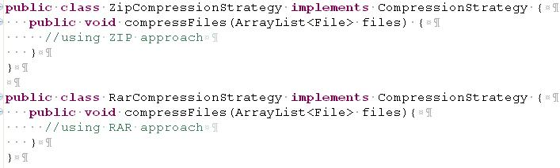
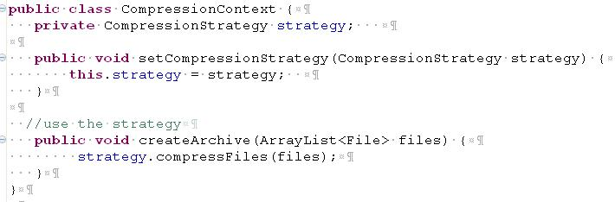
“Strategy” Design Pattern (Continued…)
And we'll need to provide our two implementations, one for zip and one for rar
Our context will provide a way for the client to compress the files. Let's say that there is a preferences setting in our application that sets which compression algorithm to use. We can change our strategy using the setCompressionStrategy method in the Context.

Slide 23
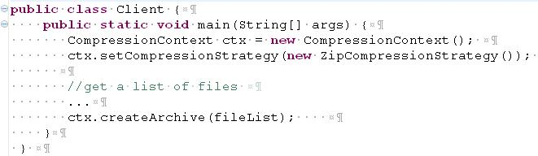
“Strategy” Design Pattern (Continued…)
It's obvious that all the client has to do now is pass through the files to the CompressionContext
Reference: 1. GOF Design Pattern Book 2. “http://java.dzone.com/articles/design-patterns-strategy”

Slide 24
“Bridge” Design Pattern
Definition: Decouple an abstraction from its implementation so that the two can vary independently.
Type: Structural Pattern
UML Diagram:
Example: Our room has some electric equipment (lights, fans etc). The equipments are arranged in a way where they could be controlled by switches. At any time, you can replace or troubleshoot electrical equipment without touching the other things.
For example, you can replace a light with another without replacing or changing the switch. Also, you can replace a switch or troubleshoot it without touching or changing the corresponding light or fan; you can even connect the light with the fan's switch and connect the fan with the light's switch, without touching the switches.

Slide 25
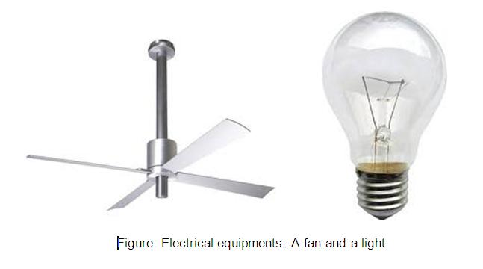
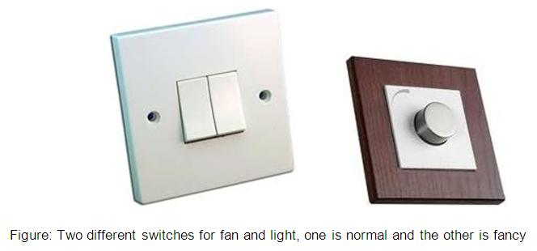
“Bridge” Design Pattern (Continued…)
Now, let's think how the lights or fans are connected with the switches so that changing one doesn't have any impact on the other. What do you think? The wire, of course!

Slide 26
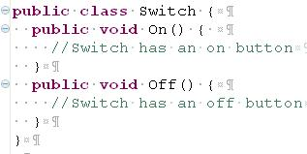
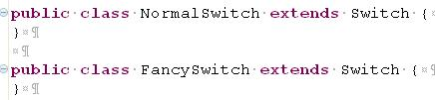
“Bridge” Design Pattern (Continued…)
We can generalize it as a bridge between the different systems that can get connected through it. The basic idea is, things shouldn't be directly connected with one another. Rather, they should be connected though some bridges or interfaces. That's what we call "loose coupling" in software world. Now, let's try to understand some key issues in the light/fan and switch analogy, and try to understand how they are designed and connected.
We have switches in our example. There may be some specific kinds of switches like normal switches, fancy ones, but, in general, they are switches. And, each switch can be turned on and off. So, we will have a base Switch class as follows:
And, as we may have some specific kinds of switches, for example a fancy switch, a normal switch etc., we will also have FancySwitch and NormalSwitch classes extending the Switch class:

Slide 27
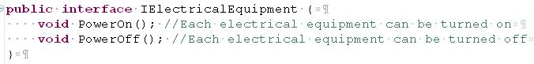
“Bridge” Design Pattern (Continued…)
Unlike switches, fan and light are two different things. For switches, we were able to use a base Switch class, but as fan and light are two different things, instead of defining a base class, an interface might be more appropriate. In general, they are all electrical equipments. So, we can define an interface, say, IElectricalEquipment, for abstracting fans and lights.
Each electrical equipment has some common functionality. They could all be turned on or off. So the interface may be as follows:
Now, we need a bridge. In real world, the wires are the bridges. But, in our object design, a switch knows how to turn on or off an electrical equipment, and the electrical equipment somehow needs to be connected with the switches, As we don't have any wire here, the only way to let the electrical equipment be connected with the switch is encapsulation.
But switches don't know the fans or lights directly. A switch actually knows about an electrical equipment IElectricalEquipment that it can turn on or off. So, that means, an ISwitch should have an IElectricalEquipment instance.

Slide 28
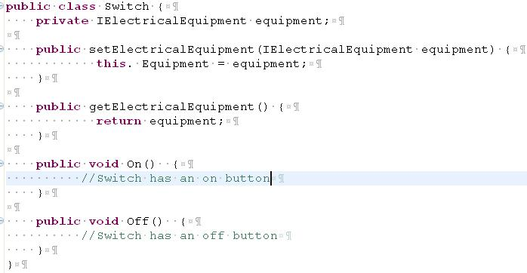
“Bridge” Design Pattern (Continued…)
Here, the encapsulated instance, which is an abstraction of fan or light (IElectricalEquipment) is the bridge. So, let's modify the Switch class to encapsulate an electrical equipment:
Let me try to define the actual electrical equipments, the fan and the light. As I see, these are electrical equipments in general, so these would simply implement the IElectricalEquipment interface.

Slide 29
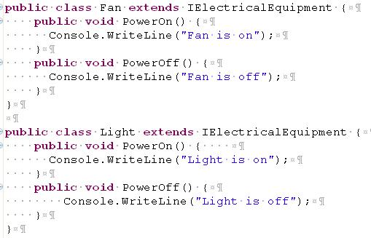
“Bridge” Design Pattern (Continued…)
Now, let's make switches work. The switches should have the ability inside them to turn on and turn off the electrical equipment (it is connected to) when the switch is turned on and off.
These are the key issues:
When the On button is pressed on the switch, the electrical equipment connected to it should be turned on.
When the Off button is pressed on the switch, the electrical equipment connected to it should be turned off.

Slide 30
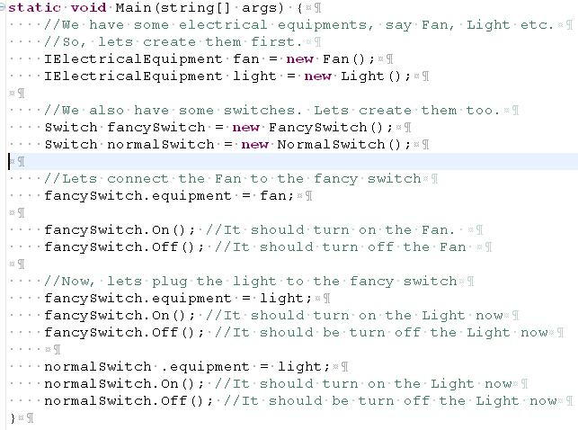
“Bridge” Design Pattern (Continued…)
So, the On() method of the actual switches should internally call the TurnOn() method of the electrical equipment, and the Off() should call the TurnOff() method on the equipment. So, the Switch class should be as follows:

Slide 31
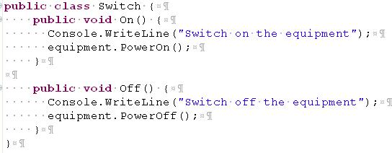
“Bridge” Design Pattern (Continued…)
Now, this certainly allows you to plug a fan from one switch to another. But you see, the opposite should also work. That means, you can change the switch of a fan or light without touching the fan or light. For example, you can easily change the switch of the light from FancySwitch to NormalSwitch.
Reference: 1. GOF Design Pattern Book 2. “http://www.codeproject.com/Articles/98598/How-I-explained-Design-Patterns-to-my-wife-Part-1”

Slide 32
“Composite” Design Pattern
Definition: Compose objects into tree structures to represent part-whole hierarchies. Composite lets clients treat individual objects and compositions of objects uniformly.
Type: Structural Pattern
UML Diagram:
Example: Computer File/Directory Structure

Slide 33
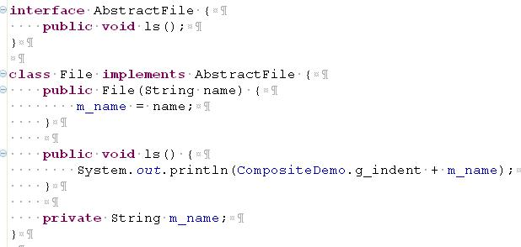
“Composite” Design Pattern (Continued…)

Slide 34
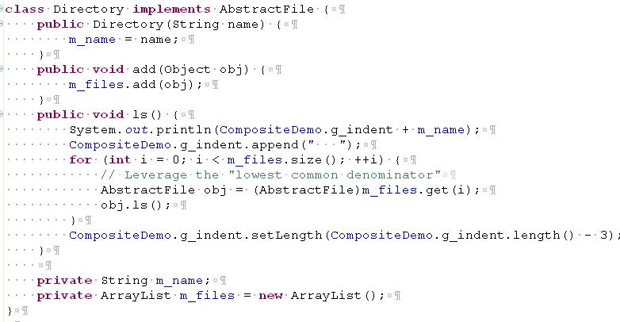
“Composite” Design Pattern (Continued…)

Slide 35
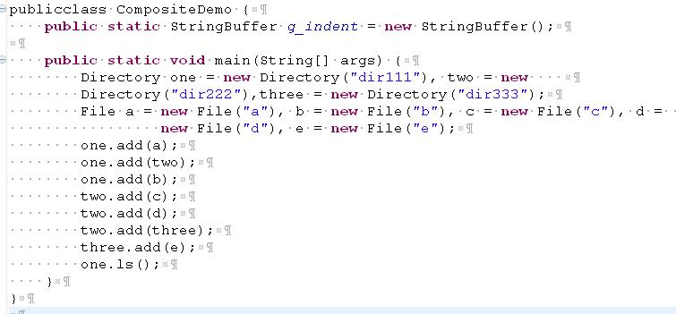
“Composite” Design Pattern (Continued…)
Output:
dir111
a dir222 c d dir333 e b
Reference: 1. GOF Design Pattern Book 2. “http://sourcemaking.com/design_patterns/composite/java/1”

Slide 36
“Factory” Design Pattern
Definition: Define an interface for creating an object, but let subclasses decide which class to instantiate. Factory Method lets a class defer instantiation to subclasses.
Type: Creational Pattern.
UML Diagram:
Example: suppose an application asks for entering the name and sex of a person. If the sex is Male (M), it displays welcome message saying Hello Mr. <Name> and if the sex is Female (F), it displays message saying Hello Ms <Name>

Slide 37
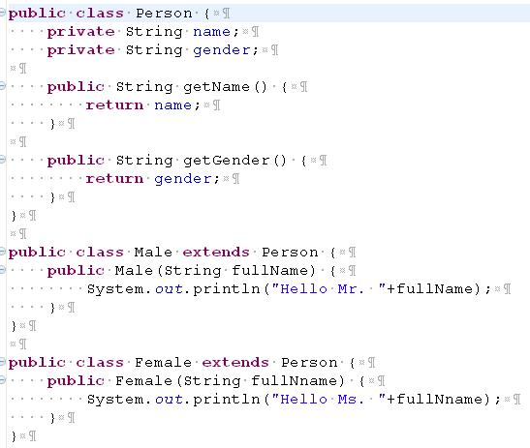
“Factory” Design Pattern (Continued…)
Salutation Example:

Slide 38
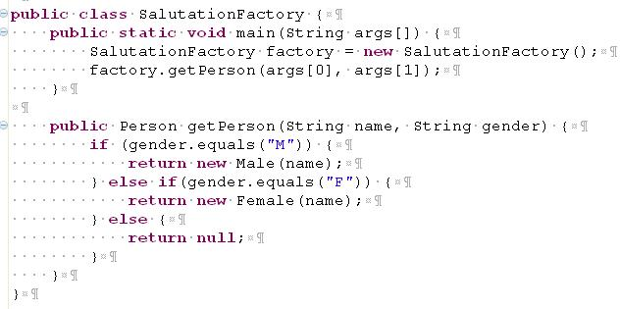
“Factory” Design Pattern (Continued…)
Salutation...
Reference: 1. GOF Design Pattern Book 2. “http://www.allapplabs.com/java_design_patterns/factory_pattern.htm”

Slide 39
“Abstract Factory” Design Pattern
Definition: Provide an interface for creating families of related or dependent objects without specifying their concrete classes.
Type: Creational Pattern
UML Diagram:

Slide 40
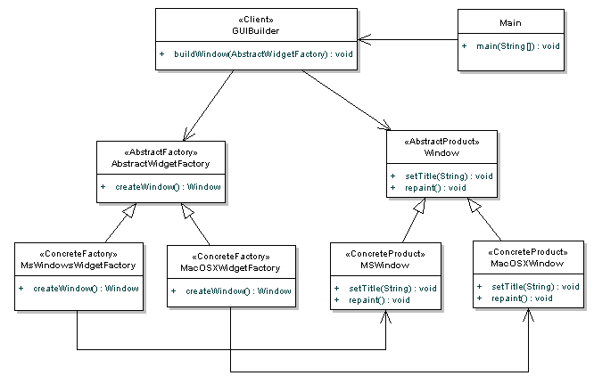
“Abstract Factory” Design Pattern (Continued…)
Example: GUI Factory Class Diagram:

Slide 41
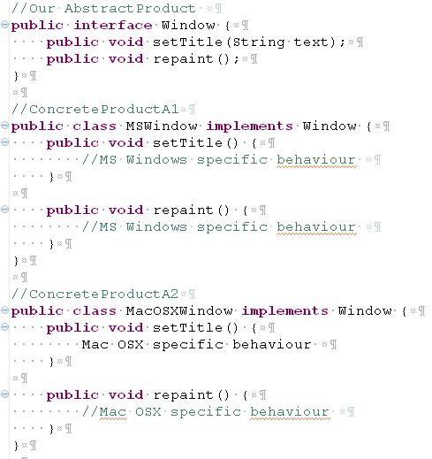
“Abstract Factory” Design Pattern (Continued…)
Example:

Slide 42
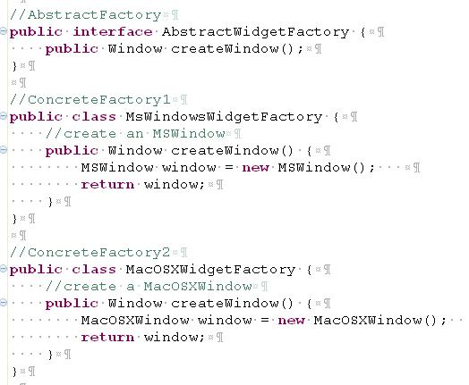
“Abstract Factory” Design Pattern (Continued…)
Example: (Continued…..)

Slide 43
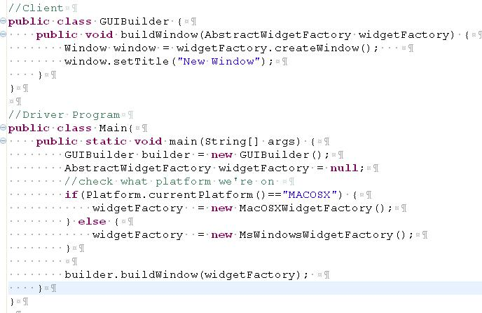
“Abstract Factory” Design Pattern (Continued…)
Example: (Continued…..)
Reference: 1. GOF Design Pattern Book 2. “http://java.dzone.com/articles/design-patterns-abstract-factory”

Slide 44
“Decorator” Design Pattern
Definition: Attach additional responsibilities to an object dynamically. Decorators provide a flexible alternative to subclassing for extending functionality.
Type: Structural Pattern
UML Diagram:
Some time we want to add responsibilities to individual objects, not to an entire class. A graphical user interface toolkit, for example, should let you add properties like borders or behaviors like scrolling to any user interface component.
One way to add responsibilities is with inheritance. Inheriting a border from another class puts a border around every subclass instance. This is inflexible, however, because the choice of border is made statically. A client can't control how and when to decorate the component with a border.

Slide 45
“Decorator” Design Pattern (Continued…)
A more flexible approach is to enclose the component in another object that adds the border. The enclosing object is called a decorator. The decorator conforms to the interface of the component it decorates so that its presence is transparent to the component's clients. The decorator forwards requests to the component and may perform additional actions (such as drawing a border) before or after forwarding. Transparency lets you nest decorators recursively, thereby allowing an unlimited number of added responsibilities.
For example, suppose we have a TextView object that displays text in a window. TextView has no scroll bars by default, because we might not always need them. When we do, we can use a ScrollDecorator to add them. Suppose we also want to add a thick black border around the TextView. We can use a BorderDecorator to add this as well. We simply compose the decorators with the TextView to produce the desired result.

Slide 46
“Decorator” Design Pattern (Continued…)
The following object diagram shows how to compose a TextView object with BorderDecorator and ScrollDecorator objects to produce a bordered, scrollable text view:

Slide 47
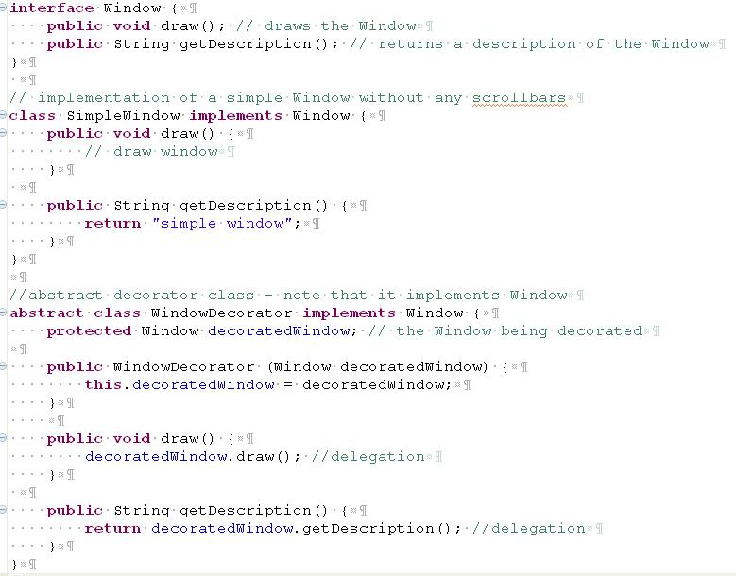
“Decorator” Design Pattern (Continued…)

Slide 48
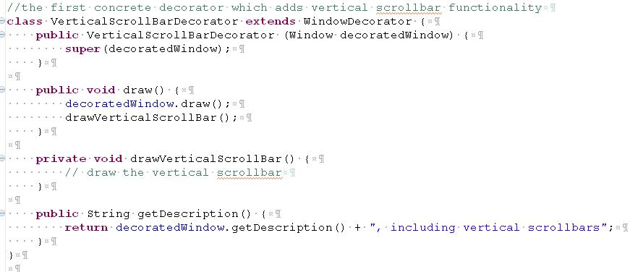
“Decorator” Design Pattern (Continued…)
The following classes contain the decorators for all Window classes, including the decorator classes themselves.

Slide 49
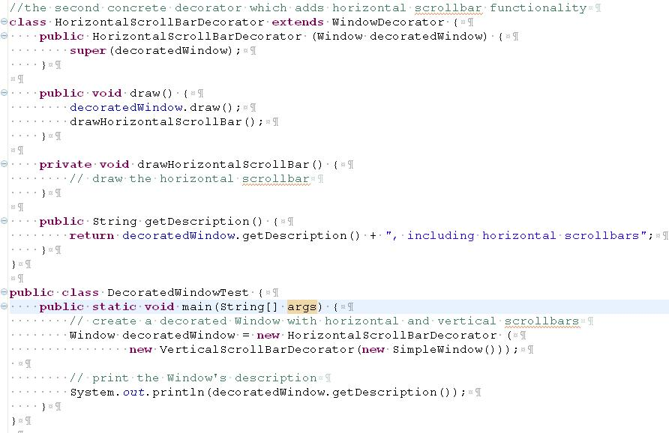
“Decorator” Design Pattern (Continued…)
Here's a test program that creates a Window instance which is fully decorated (i.e., with vertical and horizontal scrollbars), and prints its description:

Slide 50
“Decorator” Design Pattern (Continued…)
The output of this program is "simple window, including vertical scrollbars, including horizontal scrollbars". Notice how the getDescription method of the two decorators first retrieve the decorated Window's description and decorates it with a suffix
Reference: 1. GOF Design Pattern Book 2. “http://en.wikipedia.org/wiki/Decorator_pattern”

Slide 51
“Observer” Design Pattern
Definition: Define a one-to-many dependency between objects so that when one object changes state, all its dependents are notified and updated automatically.
Type: Behavioral Pattern
UML Diagram:
Many graphical user interface toolkits separate the presentational aspects of the user interface from the underlying application data. Classes defining application data and presentations can be reused independently. They can work together, too. Both a spreadsheet object and bar chart object can depict information in the same application data object using different presentations. The spreadsheet and the bar chart don't know about each other, thereby letting you reuse only the one you need. But they behave as though they do. When the user changes the information in the spreadsheet, the bar chart reflects the changes immediately, and vice versa.

Slide 52
“Observer” Design Pattern (Continued…)
This behavior implies that the spreadsheet and bar chart are dependent on the data object and therefore should be notified of any change in its state. And there's no reason to limit the number of dependent objects to two; there may be any number of different user interfaces to the same data. The Observer pattern describes how to establish these relationships. The key objects in this pattern are subject and observer. A subject may have any number of dependent observers. All observers are notified whenever the subject undergoes a change in state. In response, each observer will query the subject to synchronize its state with the subject's state.
This kind of interaction is also known as publish-subscribe. The subject is the publisher of notifications. It sends out these notifications without having to know who its observers are. Any number of observers can subscribe to receive notifications.

Slide 53
“Observer” Design Pattern (Continued…)
Participants
The classes and/or objects participating in this pattern are:
Subject (Stock)
knows its observers. Any number of Observer objects may observe a subject
provides an interface for attaching and detaching Observer objects.
ConcreteSubject (IBM)
stores state of interest to ConcreteObserver
sends a notification to its observers when its state changes
Observer (IInvestor)
defines an updating interface for objects that should be notified of changes in a subject.
ConcreteObserver (Investor)
maintains a reference to a ConcreteSubject object and stores state that should stay consistent with the subject's
implements the Observer updating interface to keep its state consistent with the subject's

Slide 54
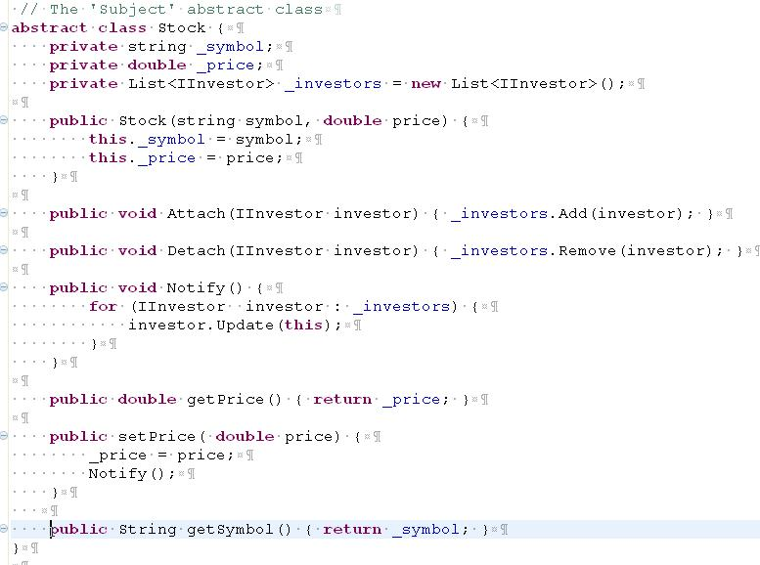
“Observer” Design Pattern (Continued…)
Example:

Slide 55
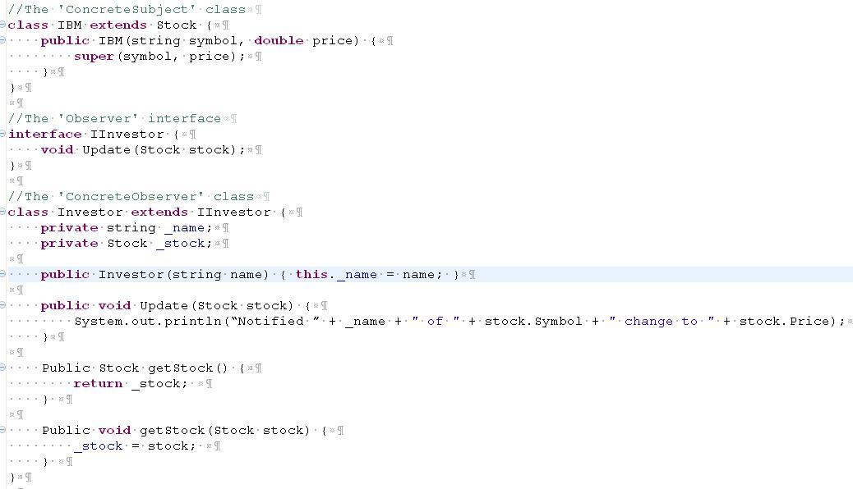
“Observer” Design Pattern (Continued…)
Example: (Continued…)

Slide 56
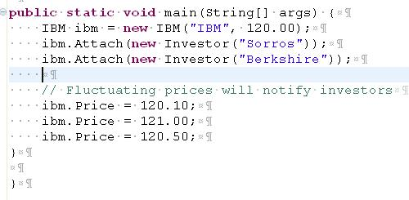
“Observer” Design Pattern (Continued…)
Example: (Continued…)
Output:
Notified Sorros of IBM's change to $120.10 Notified Berkshire of IBM's change to $120.10 Notified Sorros of IBM's change to $121.00 Notified Berkshire of IBM's change to $121.00 Notified Sorros of IBM's change to $120.50 Notified Berkshire of IBM's change to $120.50
Reference: 1. GOF Design Pattern Book 2. “http://www.dofactory.com/Patterns/PatternObserver.aspx#_self2”

Slide 57
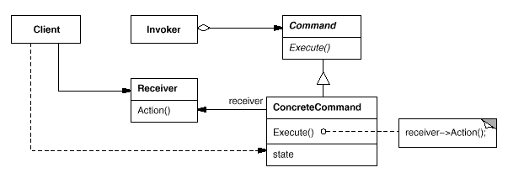
“Command” Design Pattern
Definition: Encapsulate a request as an object, thereby letting you parameterize clients with different requests, queue or log requests, and support undoable operations.
Type: Behavioral Pattern
UML Diagram:
It will be easier to understand all the above with an example. Let us think of developing a universal remote. Our UnversalRemote will have only two buttons, one is to power on and another is to mute all associated ConsumerElectronics. For ConsumerElectronics we will have couple of implementations Television and SoundSystem. Button is a class that is the invoker of an action.
OnCommand is used to switch on a ConsumerElectronics. While instantaiting OnCommand client needs to set the receiver. Here receiver is either Television or SoundSystem. UniversalRemote class will maintain all the receivers and will provide a method to identify the currently active receiver.

Slide 58
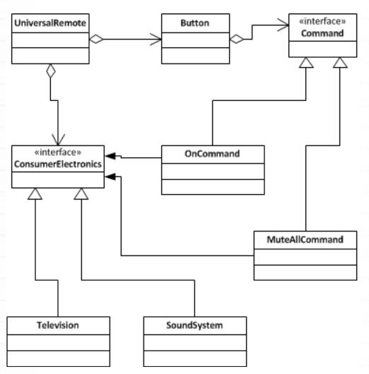
“Command” Design Pattern (Continued…)
When an instance of a invoker is created, a concrete command is passed to it. Invoker does not know how to perform an action. All it does is honoring the agreement with the Command. Invoker calls the execute() method of the set concrete command.
Class Diagram:

Slide 59
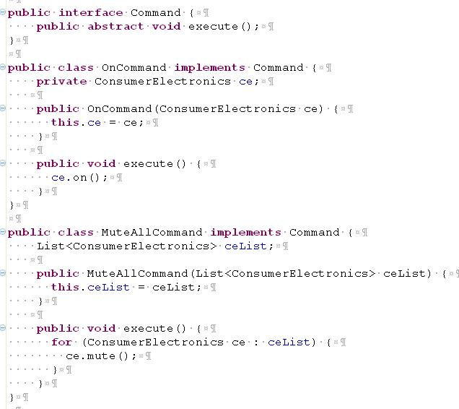
“Command” Design Pattern (Continued…)
Example:

Slide 60
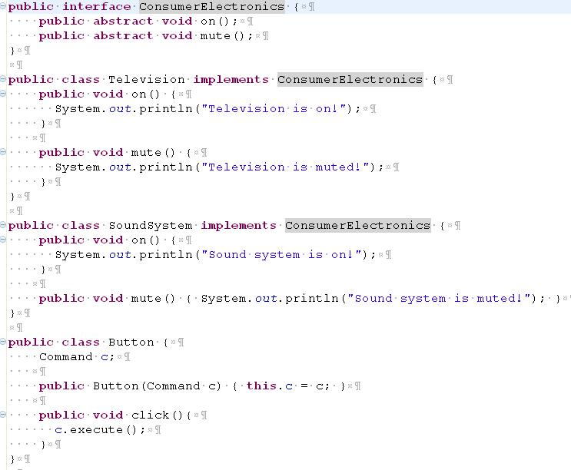
“Command” Design Pattern (Continued…)
Example: (Continued…)

Slide 61
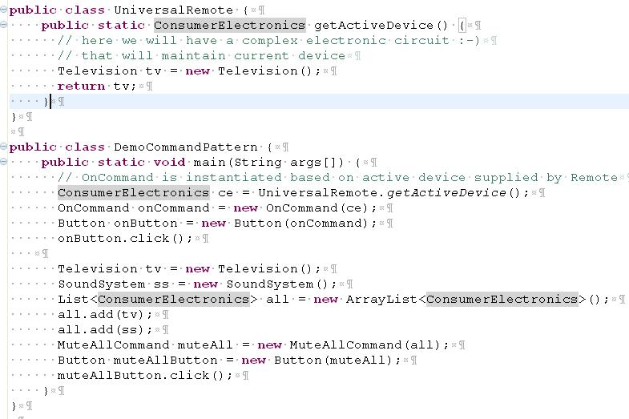
“Command” Design Pattern (Continued…)
Example: (Continued…)

Slide 62
“Command” Design Pattern (Continued…)
Important Points on Command Pattern:
Command pattern helps to decouple the invoker and the receiver. Receiver is the one which knows how to perform an action.
Command helps to implement call back in java.
Helps in terms of extensibility as we can add new command without changing existing code.
Command defines the binding between receiver and action.
A command should be able to implement undo and redo operations.
Command Pattern in JDK:
Implementations of java.lang.Runnable and javax.swing.Action follows command design pattern.
Reference: 1. GOF Design Pattern Book 2. “http://javapapers.com/design-patterns/command-design-pattern/”

Slide 63
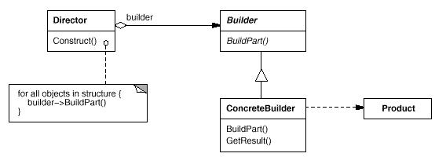
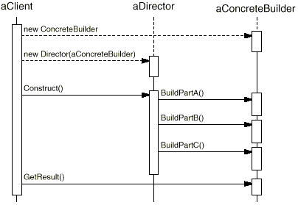
“Builder” Design Pattern
Definition: Separate the construction of a complex object from its representation so that the same construction process can create different representations.
Type: Creational Pattern
UML Diagram:
Sequence Diagram:

Slide 64
“Builder” Design Pattern (Continued…)
Participants:
The classes and/or objects participating in this pattern are:
Builder (PizzaBuilder)
specifies an abstract interface for creating parts of a Product object.
ConcreteBuilder (HawaiianPizzaBuilder, SpicyPizzaBuilder)
constructs and assembles parts of the product by implementing the Builder interface.
defines and keeps track of the representation it creates.
provides an interface for retrieving the product (e.g., getPizza()).
Director (Waiter)
constructs an object using the Builder interface.
Product (HawaiianPizza, SpicyPizza)
represents the complex object under construction. ConcreteBuilder builds the product's internal representation and defines the process by which it's assembled.
includes classes that define the constituent parts, including interfaces for assembling the parts into the final result.

Slide 65

“Builder” Design Pattern (Continued…)
Example:

Slide 66

“Builder” Design Pattern (Continued…)
Example: (Continued…)

Slide 67
“Builder” Design Pattern (Continued…)
What is the difference between abstract factory and builder pattern?
Abstract factory may also be used to construct a complex object, then what is the difference with builder pattern? In builder pattern emphasis is on ‘step by step’. Builder pattern will have many number of small steps. Those every steps will have small units of logic enclosed in it. There will also be a sequence involved. It will start from step 1 and will go on upto step n and the final step is returning the object. In these steps, every step will add some value in construction of the object. That is you can imagine that the object grows stage by stage. Builder will return the object in last step. But in abstract factory how complex the built object might be, it will not have step by step object construction.
Sample builder design pattern implementation in Java API:
DocumentBuilderFactory , StringBuffer, StringBuilder are some examples of builder pattern usage in java API.
Reference: 1. GOF Design Pattern Book 2. “http://sourcemaking.com/design_patterns/builder/java/2” 3. “http://javapapers.com/design-patterns/builder-pattern/”

Slide 68


“Flyweight” Design Pattern
Definition: Use sharing to support large numbers of fine-grained objects efficiently.
Type: Structural Pattern
UML Diagram:

Slide 69
“Flyweight” Design Pattern (Continued…)
Flyweight is used when there is a need to create high number of objects of almost similar nature. High number of objects consumes high memory and flyweight design pattern gives a solution to reduce the load on memory by sharing objects. It is achieved by segregating object properties into two types intrinsic and extrinsic.
Sharing is key in flyweight pattern, and we need to judiciously decide if this pattern can be applied.
When to Use Flyweight Design Pattern:
Need to create large number of objects.
Because of the large number when memory cost is a constraint.
When most of the object attributes can be made external and shared.
The application must not mandate unique objects, as after implementation same object will be used repeatedly.
Its better when extrinsic state can be computed rather than stored.
How to Apply Flyweight:
The object which we are going to create in high number should be analyzed before going for flyweight. Idea is to create lesser number of objects by reusing the same objects. Create smaller groups of objects and they should be reused by sharing. Closely look at objects properties and they can be segregated as two types intrinsic and extrinsic. Sharing is judged with respect to a context. Let's take the example of editors.
Consider a simple text editor where we can use only alphabet set A to Z. If we are going to create 100-page document using this editor, we may have 200000 (2000 X 100) characters (assuming 2000 characters / page). Without flyweight we will create 200000 objects to have fine grained control. With such fine control, every character can have its own characteristics like color, font, size, etc. How do we apply flyweight here?

Slide 70
“Flyweight” Design Pattern (Continued…)
Intrinsic and Extrinsic State
Create only 26 objects for (A to Z) mapping every unique characters. These 26 objects will have intrinsic state as its character. That is object ‘a’ will have state as character ‘a’. Then what happens to color, font and size? Those are the extrinsic state and will be passed by client code. 26 objects will be in store, client code will get the needed character/object and pass the extrinsic state to it with respect to the context. With respect to context means, ‘a’ in first line may come in red color and the same character may come in blue color in different line.
Flyweight Implementation
The object with intrinsic state is called flyweight object. When we implement flyweight, we create concrete objects and have the intrinsic state stored in that. To create those concrete objects, we will have factory and that is called Flyweight factory. This factory is to ensure that the objects are shared, and we don’t end up creating duplicate objects.
Let us take an example scenario of drawing. We need to draw different geometrical shapes like rectangles and ovals in huge number. Every shape may vary in color, size, fill type, font used. For implementation's sake let's limit our shapes to two rectangle and oval. Every shape will be accompanied by a label which directly maps it with the shape. That is all rectangles will have label as ‘R’ and all ovals will have label as ‘O’.
Now our flyweight will have intrinsic state as label only. Therefore, we will have only two flyweight objects. The varying properties color, size, fill type and font will be extrinsic. We will have a flyweight factory that will maintain the two flyweight objects and distribute to client accordingly. There will be an interface for the flyweights to implement so that we will have a common blueprint and that is the flyweight interface.

Slide 71

“Flyweight” Design Pattern (Continued…)
Client code will use random number generators to create extrinsic properties. We are not storing the extrinsic properties
anywhere, we will calculate on the fly and pass it. Use of random number generator is for convenience.
Example:

Slide 72

“Flyweight” Design Pattern (Continued…)
Example: (Continued… )

Slide 73

“Flyweight” Design Pattern (Continued…)
Example: (Continued… )

Slide 74

“Flyweight” Design Pattern (Continued…)
Example: (Continued… )

Slide 75

“Flyweight” Design Pattern (Continued…)
Example: (Continued… )

Slide 76

“Flyweight” Design Pattern (Continued…)
Output:
Reference: 1. GOF Design Pattern Book 2. “http://javapapers.com/design-patterns/flyweight-design-pattern/”

Slide 77

“Interpreter” Design Pattern
Definition: Given a language, define a representation for its grammar along with an interpreter that uses the representation to interpret sentences in the language.
Type: Behavioral Pattern
UML Diagram:
The Interpreter pattern describes how to define a grammar for simple languages, represent sentences in the language, and interpret these sentences. In this example, the pattern describes how to define a grammar for regular expressions, represent a particular regular expression, and how to interpret that regular expression.
When Would I Use This Pattern?
Use the Interpreter pattern when there is a language to interpret, and you can represent statements in the language as abstract syntax trees.

Slide 78
“Interpreter” Design Pattern (Continued…)
Example: The following Reverse Polish notation(Reverse Polish notation (RPN) is a mathematical notation wherein every operator follows all of its operands. It is also known as Postfix notation. Example: 3 4 +) example illustrates the interpreter pattern. The grammar
expression ::= plus | minus | variable | number
plus ::= expression expression '+'
minus ::= expression expression '-'
variable ::= 'a' | 'b' | 'c' | ... | 'z'
digit = '0' | '1' | ... '9'
number ::= digit | digit number
defines a language which contains reverse Polish expressions like:
a b +
a b c + -
a b + c a - -
Following the interpreter pattern there is a class for each grammar rule

Slide 79

“Interpreter” Design Pattern (Continued…)
Example:

Slide 80

“Interpreter” Design Pattern (Continued…)
Example: (Continue…)

Slide 81

“Interpreter” Design Pattern (Continued…)
While the interpreter pattern does not address parsing a parser is provided for completeness.

Slide 82

“Interpreter” Design Pattern (Continued…)
Finally evaluating the expression "w x z - +" with w = 5, x = 10, and z = 42.
Reference: 1. GOF Design Pattern Book 2. “http://en.wikipedia.org/wiki/Interpreter_pattern”

Slide 83

“Prototype” Design Pattern
Definition: Specify the kinds of objects to create using a prototypical instance and create new objects by copying this prototype.
Type: Creational Pattern
UML Diagram:
When to use this pattern: Use the Prototype pattern when a system should be independent of how its products are created, composed, and represented; and
when the classes to instantiate are specified at run-time, for example, by dynamic loading; or
to avoid building a class hierarchy of factories that parallels the class hierarchy of products; or
when instances of a class can have one of only a few different combinations of state. It may be more convenient to install a corresponding number of prototypes and clone them rather than instantiating the class manually, each time with the appropriate state.

Slide 84

“Prototype” Design Pattern (Continued…)
Example:

Slide 85

“Prototype” Design Pattern (Continued…)
Example: (Continue…)

Slide 86
“Prototype” Design Pattern (Continued…)
Output:
Cluck cluck World. I am Chicken1. I have 2 legs.
Cluck cluck World. I am Chicken2. I have 2 legs.
Cluck cluck World. I am Chicken4. I have 2 legs.
Meeeeeee World. I am Sheep1. I have 4 legs.
Meeeeeee World. I am Sheep2. I have 4 legs.
Meeeeeee World. I am Sheep3. I have 4 legs.
Reference: 1. GOF Design Pattern Book 2. “http://java.dzone.com/articles/intro-design-patterns-prototype”

Slide 87


“Proxy” Design Pattern
Definition: Provide a surrogate or placeholder for another object to control access to it.
Type: Structural Pattern
UML Diagram:
Here's a possible object diagram of a proxy structure at run-time:
Motivation: One reason for controlling access to an object is to defer the full cost of its creation and initialization until we actually need to use it. Consider a document editor that can embed graphical objects in a document. Some graphical objects, like large raster images, can be expensive to create. But opening a document should be fast, so we should avoid creating all the expensive objects at once when the document is opened. This isn't necessary anyway, because not all of these objects will be visible in the document at the same time.

Slide 88

“Proxy” Design Pattern (Continued…)
These constraints would suggest creating each expensive object on demand, which in this case occurs when an image becomes visible. But what do we put in the document in place of the image? And how can we hide the fact that the image is created on demand so that we don't complicate the editor's implementation? This optimization shouldn't impact the rendering and formatting code, for example.
The solution is to use another object, an image proxy, that acts as a stand-in for the real image. The proxy acts just like the image and takes care of instantiating it when it's required.
The image proxy creates the real image only when the document editor asks it to display itself by invoking its Draw operation. The proxy forwards subsequent requests directly to the image. It must therefore keep a reference to the image after creating it.
Let's assume that images are stored in separate files. In this case we can use the file name as the reference to the real object. The proxy also stores its extent, that is, its width and height. The extent lets the proxy respond to requests for its size from the formatter without actually instantiating the image.

Slide 89

“Proxy” Design Pattern (Continued…)
Example:

Slide 90

“Proxy” Design Pattern (Continued…)
Example: (Continued…)

Slide 91
“Proxy” Design Pattern (Continued…)
Output:
Loading HiRes_10MB_Photo1
Displaying HiRes_10MB_Photo1
Displaying HiRes_10MB_Photo1
Loading HiRes_10MB_Photo2
Displaying HiRes_10MB_Photo2
Displaying HiRes_10MB_Photo2
Displaying HiRes_10MB_Photo1
Reference: 1. GOF Design Pattern Book 2. “http://en.wikipedia.org/wiki/Proxy_pattern”

Slide 92

“Iterator” Design Pattern
Definition: Provide a way to access the elements of an aggregate object sequentially without exposing its underlying representation.
Type: Behavioral Pattern
UML Diagram:
Motivation: An aggregate object such as a list should give you a way to access its elements without exposing its internal structure. Moreover, you might want to traverse the list in different ways, depending on what you want to accomplish. But you probably don't want to bloat the Listinterface with operations for different traversals, even if you could anticipate the ones you will need. You might also need to have more than one traversal pending on the same list.
The Iterator pattern lets you do all this. The key idea in this pattern is to take the responsibility for access and traversal out of the list object and put it into an iterator object. The Iterator class defines an interface for accessing the list's elements. An iterator object is responsible for keeping track of the current element; that is, it knows which elements have been traversed already.

Slide 93

“Iterator” Design Pattern (Continued…)
Example:

Slide 94

“Iterator” Design Pattern (Continued…)
Example: (Continued…)
Reference: 1. GOF Design Pattern Book 2. “http://www.oodesign.com/iterator-pattern.html”

Slide 95

“Template Method” Design Pattern
Definition: Define the skeleton of an algorithm in an operation, deferring some steps to subclasses. Template Method lets subclasses redefine certain steps of an algorithm without changing the algorithm's structure.
Type: Behavioral Pattern
UML Diagram:
Template methods are a fundamental technique for code reuse. They are particularly important in class libraries, because they are the means for factoring out common behavior in library classes.
Template methods lead to an inverted control structure that's sometimes referred to as "the Hollywood principle," that is, "Don't call us, we'll call you". This refers to how a parent class calls the operations of a subclass and not the other way around.

Slide 96
“Template Method” Design Pattern (Continued…)
Applicability:
to implement the invariant parts of an algorithm once and leave it upto subclasses to implement the behavior that can vary.
when common behavior among subclasses should be factored and localized in a common class to avoid code duplication. This is a good example of "refactoring to generalize". You first identify the differences in the existing code and then separate the differences into new operations. Finally, you replace the differing code with a template method that calls one of these new operations
We to control subclasses extensions. You can define a template method that calls "hook" operations at specific points, thereby permitting extensions only at those points.

Slide 97

“Template Method” Design Pattern (Continued…)
Example:

Slide 98

“Template Method” Design Pattern (Continued…)
Example: (Continued…)
Reference: 1. GOF Design Pattern Book 2. “http://www.codeproject.com/Articles/186191/Template-Method-Design-Pattern”

Slide 99

Thank You
Image Placeholder
Notes:
Note: First “Right Click” on the Gradient background, go to “Order” option and “Send it to Back”, then insert your picture into “Image Placeholder”, “Right Click” on the picture and again go to “Order” option and “Send it to Back” to get the “Gradient” effect.

